Slide 1
EDA Regional Sales Analysis
How does each region, state, or warehouse perform over time?

Slide 2
Problem Statement
Sales teams often lack a clear, data-driven understanding of regional performance, making it difficult to identify growth opportunities and optimize resources. This project aims to analyze and visualize regional sales data to uncover trends, evaluate profitability, and support strategic decision-making.

Slide 3
Approach
Will take a look at sales by region
Will take a look at sales by year
By region
By warehouse
Excluding 2018 since it is incomplete

Slide 4
Data Overview
Regional Sales Dataset Excel spreadsheet (.xlsx), which contains the following:
Sales Orders for all of 2014-2017 and a small portion of 2018
2018 omitted from analysis due to incompleteness
Listing of customers
List of regions, including city and state data
List of states and the region where each is located
List of products
List of 2017 budget amounts for each product

Slide 5
Project Workflow
Importing of each tab of Regional Sales Dataset into separate data frames
Retitling of columns where needed
Grouping of total unit costs by various attributes, depending on analysis performed.
Visualization of each analysis with graphs and charts

Slide 6
Exploratory Data Analysis
Where we dig into the details!

Slide 7
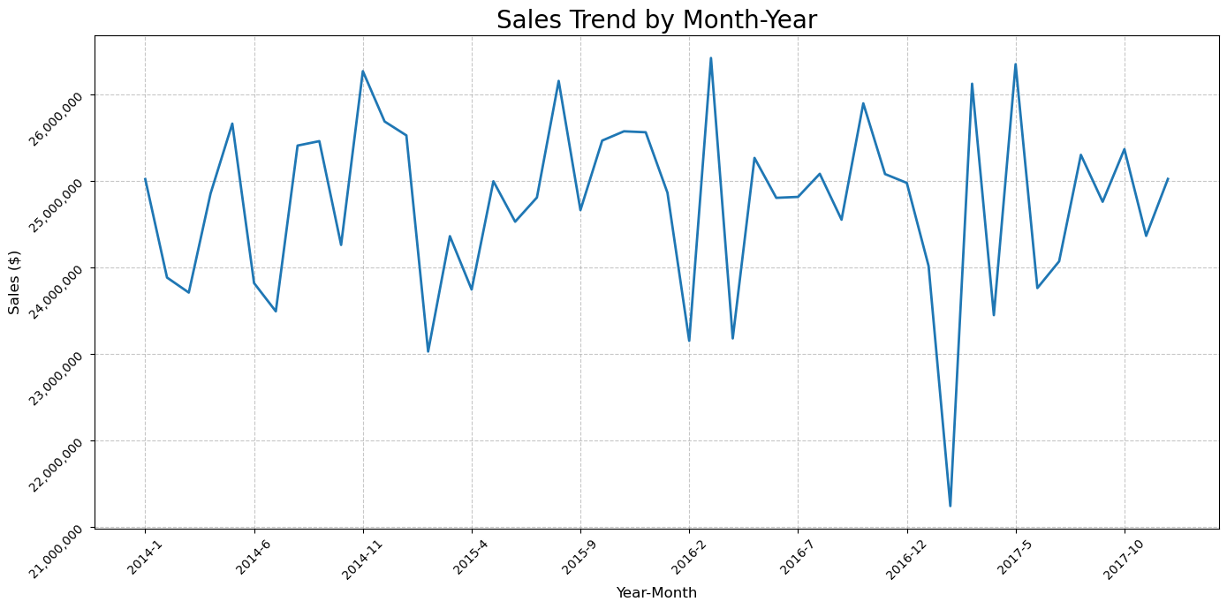
Sales Over Time
Consistent throughout 2014 – 2017
Temporary downward fluctuations, usually in one of the winter months
January or February
Could be caused by harsh winter weather in some parts of the United States
Any downward fluctuations immediately offset by strong rebound in following month

Slide 8
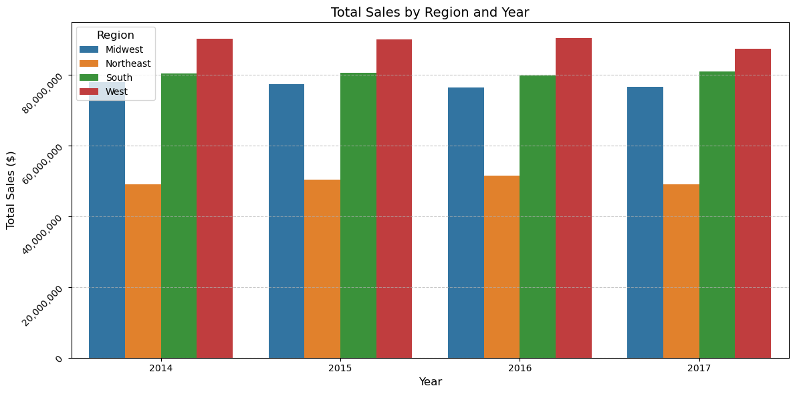
Sales by Region by Year
Each region consistent each year
Each region the same relative to the other regions
West consistently generates the most sales
Presumably because this is where California is located
Northeast is least by significant margin.

Slide 9
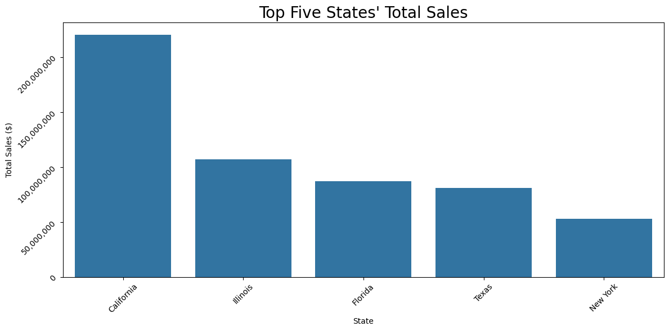
Sales by Top States
California contains the largest number of sales, followed by Illinois, Florida, Texas, and New York
Presumably, these states contain some of the largest markets

Slide 10
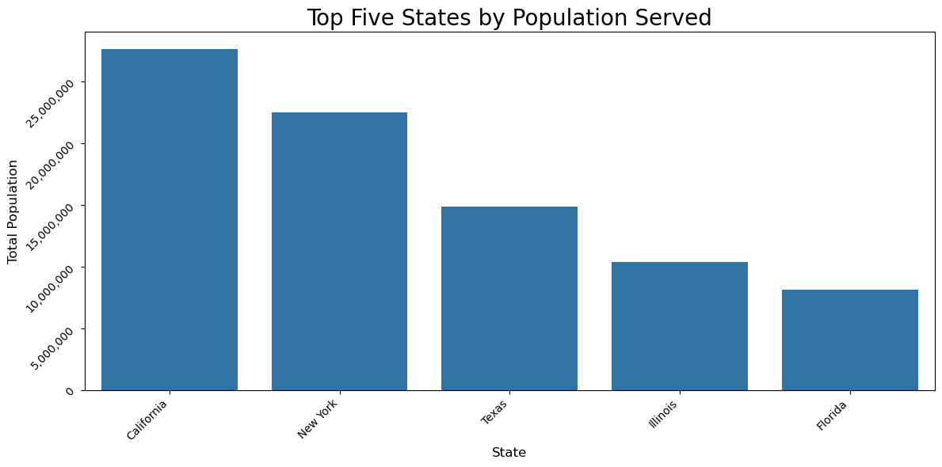
Population Served by State
Interestingly, many of the states with the top sales totals also have the top population totals of regions served.
These states contain many of the largest population centers as measured by populations of counties.

Slide 11
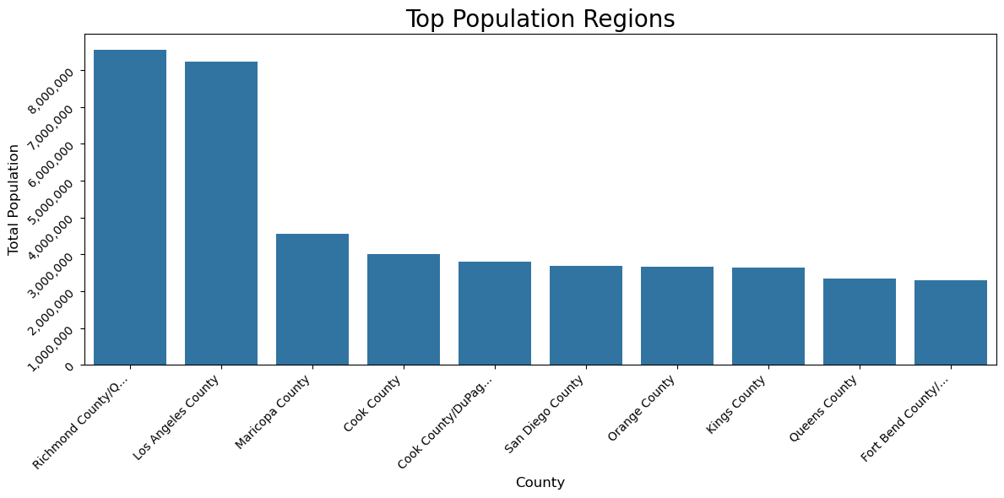
Top Population Regions

Slide 12
Which States are These Regions Located?
 | county | state | population
349 | Richmond County/Queens County/Kings County/New... | New York | 8550405
240 | Los Angeles County | California | 8219148
253 | Maricopa County | Arizona | 3546258
91 | Cook County | Illinois | 3013111
92 | Cook County/DuPage County | Illinois | 2795239
364 | San Diego County | California | 2690803
309 | Orange County | California | 2659259
218 | Kings County | New York | 2636735
342 | Queens County | New York | 2339150
152 | Fort Bend County/Harris County/Montgomery County | Texas | 2296224
Not surprisingly, many of the top states in terms of population and sales have regions in this list.
Many large U.S. cities are in these regions, such as:
New York City
Los Angeles
Houston
Chicago
San Diego
Phoenix

Slide 13
What About the Least Populated Regions?
 | county | state | population
147 | Floyd County | Indiana | 50145
158 | Galveston County | Texas | 50180
411 | Thurston County | Washington | 50302
314 | Ottawa County | Michigan | 50340
51 | Cache County | Utah | 50371
241 | Loudoun County | Virginia | 51209
409 | Tarrant County/Denton County/Dallas County | Texas | 51404
168 | Hall County | Nebraska | 51440
55 | Calhoun County | Michigan | 51589
160 | Garfield County | Oklahoma | 51776
A population of 50,000 seems to be the minimum threshold.
Some of these are in more rural areas
However, some are near larger cities.
Tarrant/Denton/Dallas counties is near Dallas, Texas.

Slide 14
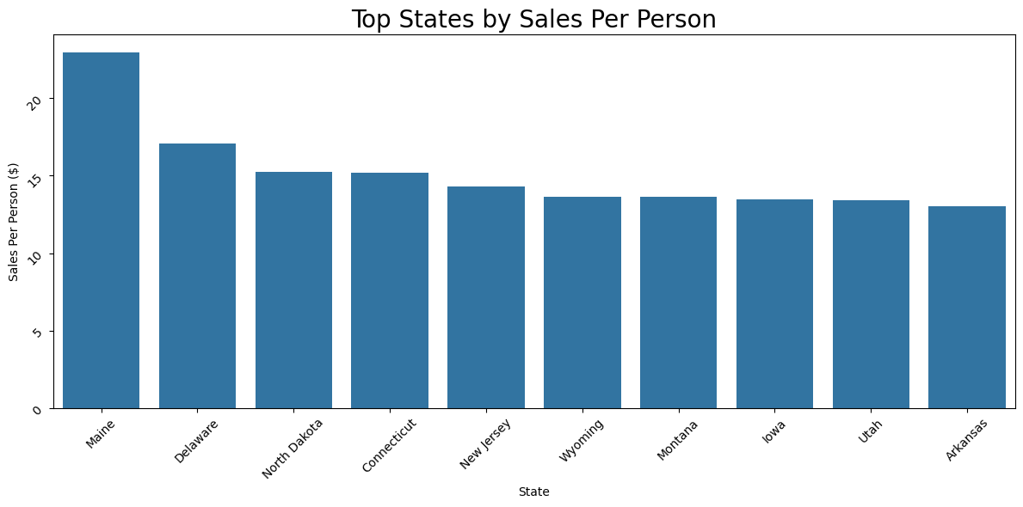
Which States Have the Most Sales Per Person?
None of these states are in top list for population or in sales.
These may have some of the least population served.

Slide 15
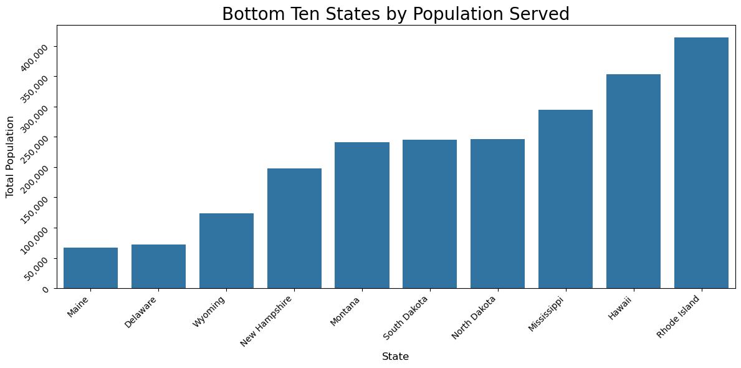
Are These States Serving the Least Population?
Indeed, some of those states have of the least population served.
Maine, Delaware, Wyoming, North Dakota generate the most sales per person.

Slide 16
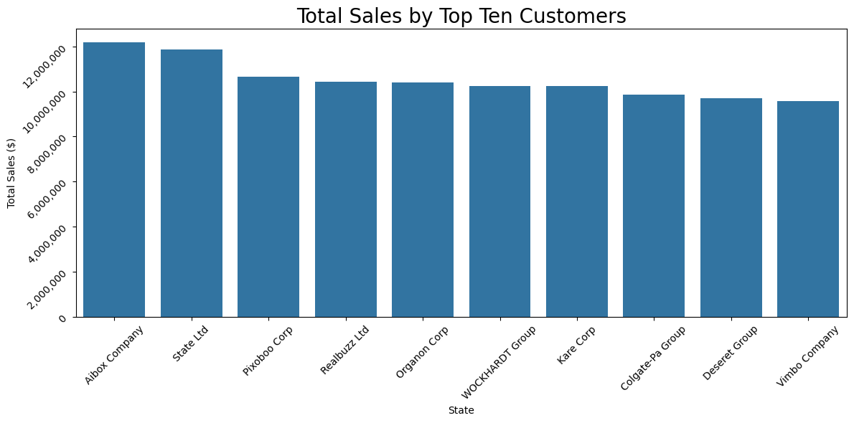
Top Customers
Some generated over $10 million in sales.
These are the customers to maintain best business relationships with.

Slide 17
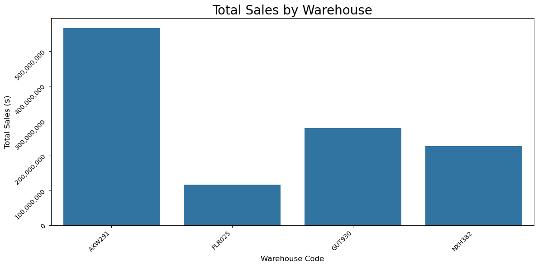
Sales by Warehouse
AXW291 generates the most sales by far
FLR025 generates the least amount of sales
These trends hold in general over time.

Slide 18
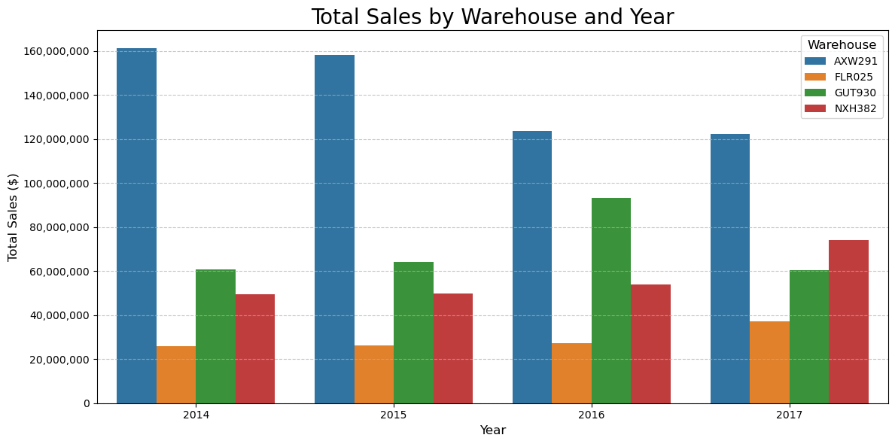
Yearly Sales by Warehouse
AXW291 generates the most sales each year, though decreases over time
FLR025 still generates the least amount of sales
GUT 930 and NXH382 generate greater share of sales over time

Slide 19
Key Insights
Total Unit Costs are mostly consistent throughout 2014-2017
Slight, but short-lived, fluctuations during certain times of a year
Slight shifts of the burden between warehouses in 2016-2017
More population means more Total Unit Costs
California reigns supreme!
Many of the United States’ largest cities
Many less-populous states have greater sales density
Can still generate decent sales in less-populated areas
Largest key customers must be retained for future success

Slide 20
Recommendations
Continue generating sales where you have success and nurture these valuable relationships
Large population centers such as those in California, New York, Chicago, etc.
Take care of your largest customers
Improve relations with smaller customers
Continue sales efforts in rural or less-populous areas
These generate greater sales density
Continue with 50,000 population threshold for feasibility
Share the burden with other warehouses by expanding other warehouses’ territories slightly.
Will help increase performance for those warehouses
Will better enable your largest warehouse to take care of largest sales generators

Slide 21

Thank you

